Slide 1
Penetration Testing
Chapter 6
Encryption and Password Cracking

Slide 2
Objectives
Understand basic cryptographic principles
Understand the fundamentals of encryption
Describe the most common ciphers in use today
Identify the most common attacks on passwords
Use various programs for cracking passwords

Slide 3
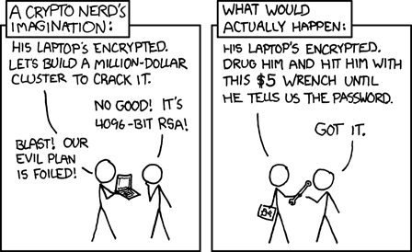
Encryption and Password Cracking
Strong passwords
Good defense against unwanted entry
Guessing, stealing, or cracking passwords
Foundation of defeating any kind of security

Slide 4
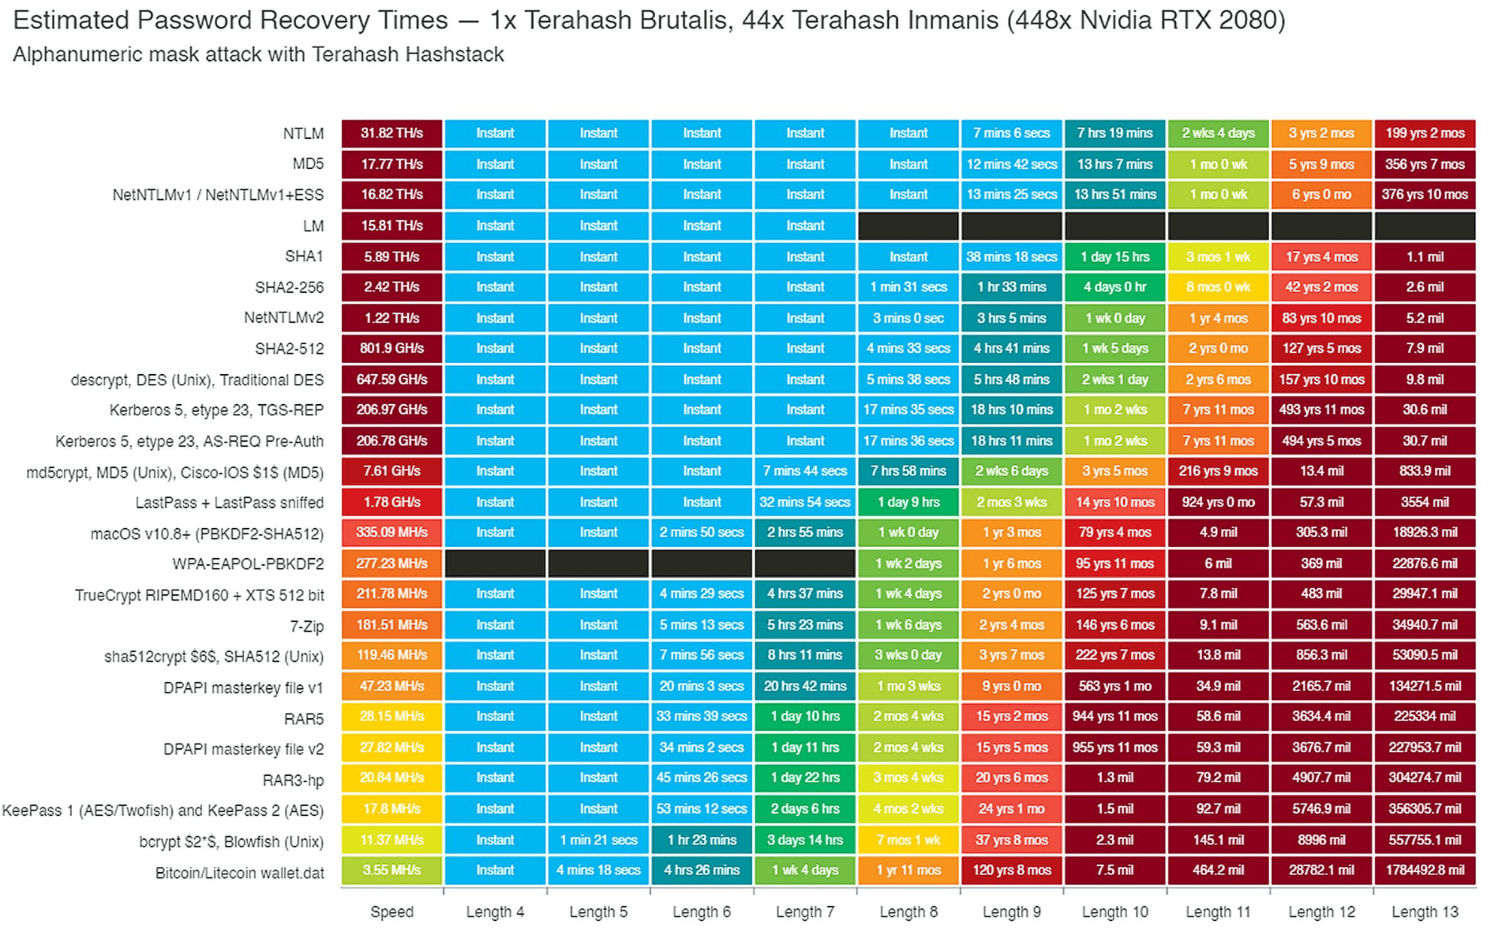
Encryption and Password Cracking
https://spycloud.com/blog/cryptography-of-password-cracking/

Slide 5
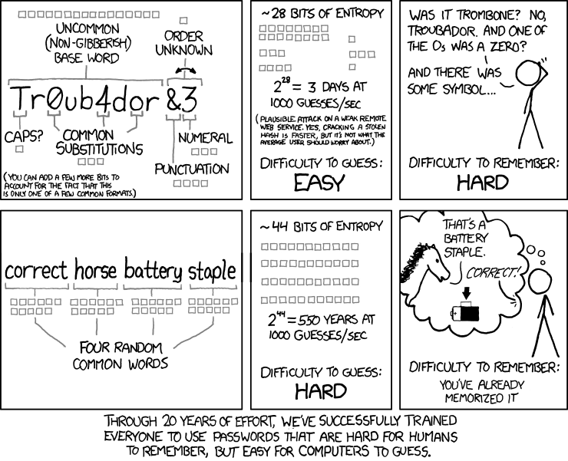
Encryption and Password Cracking
https://imgs.xkcd.com/comics/password_strength.png

Slide 6
Encryption and Password Cracking
Entropy as a measure of password strength
Password strength is specified by the amount of information entropy, measured in shannon (Sh) and is a concept from Information Theory. It can be regarded as the minimum number of bits necessary to hold the information in a password of a given type. A related measure is the base-2 logarithm of the number of guesses needed to find the password with certainty, which is commonly referred to as the "bits of entropy". A password with 44 bits of entropy would be as strong as a string of 44 bits chosen randomly, for example by a fair coin toss. Put another way, a password with 44 bits of entropy would require 2⁴⁴ (17,592,186,044,416) attempts to exhaust all possibilities during a brute force search.
In one analysis of over 3 million eight-character passwords, the letter "e" was used over 1.5 million times, while the letter "f" was used only 250,000 times. A uniform distribution would have had each character being used about 900,000 times. The most common number used is "1", whereas the most common letters are a, e, o, and r.

Slide 7
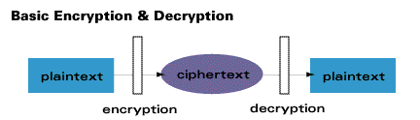
Cryptography
Cryptography
Encryption will transform the plaintext document into a ciphertext
Decryption will reverse it, transforming the ciphertext back into plaintext

Slide 8
Cryptography
Ciphers
Substitution Cipher
A method of encrypting in which units of plaintext are replaced with the ciphertext, in a defined manner, with the help of a key; the "units" may be single letters (the most common), pairs of letters, triplets of letters, mixtures of the above, and so forth. The receiver deciphers the text by performing the inverse substitution process to extract the original message.
Transposition Cipher
A method of encryption which scrambles the positions of characters (transposition) without changing the characters themselves.
They differ from substitution ciphers, which do not change the position of units of plaintext but instead change the units themselves. Despite the difference between transposition and substitution operations, they are often combined, such as with AES.
https://en.wikipedia.org/wiki/Cipher

Slide 9
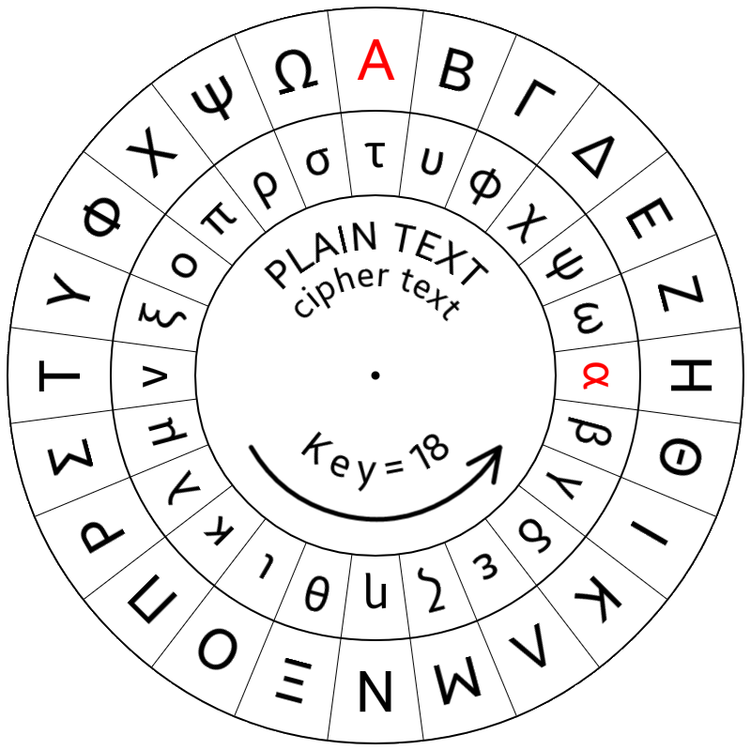
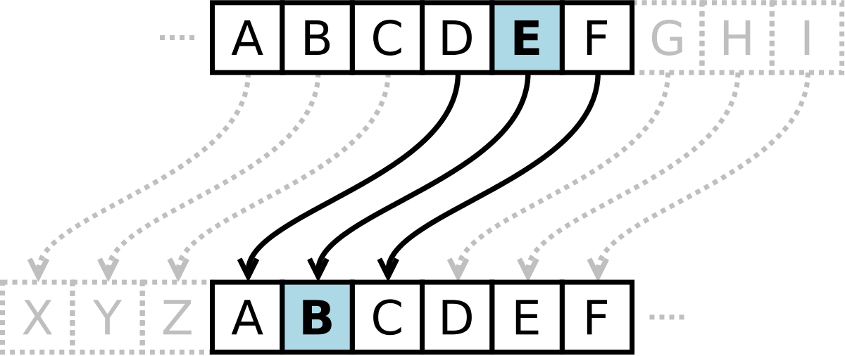
Cryptography
The Caesar Cipher, used by Julius Caesar around 58 BC, is a substitution cipher that shifts letters in a message to make it unreadable if intercepted.

Slide 10
Cryptography
The Caesar Cipher is known as a Monoalphabetic Substitution due to the simplicity of the encryption method
If we use the text ‘Hello’ as our message, and shift the letters by 5 characters to the right, we get the encrypted message of ‘Mjqqt’
Even without the cipherkey it can easily be brute forced within 25 attempts, or even guessed.
By the 14th century, we started to see the appearance of Polyalphabetic Substitution where each plaintext letter can be assigned more than one substitute
The Vigenère Cipher (16th century) is a method of encrypting alphabetic text where each letter of the plaintext is encoded with a different Caesar Cipher, whose increment is determined by the corresponding letter of another text, the key.

Slide 11
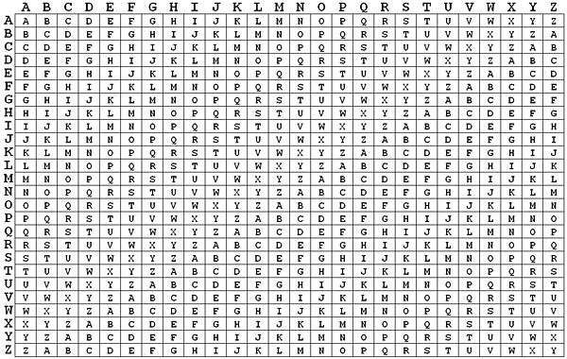
Cryptography
Vigenère Cipher
By combining the message with a key, we can encrypt in a way that alters the letter so that repeated letters are different
If we use the text ‘Hello’ as our message, and the key being ‘key’, we get the encrypted message of ‘Rijvs’

Slide 12
Cryptography (continued)
One Time Pad (OTP)
An encryption technique that cannot be cracked, but requires the use of a single-use pre-shared key that is larger than or equal to the size of the message being sent. In this technique, a plaintext is paired with a random secret key (also referred to as a one-time pad).
The Vigenère Cipher is very similar to this, however there is one major difference; The Vigenère cipher reuses the key, especially if the ciphertext is longer than the key, which makes it vulnerable to certain attacks. The One-Time Pad uses a key that is as long as the message itself, providing a higher level of security.

Slide 13
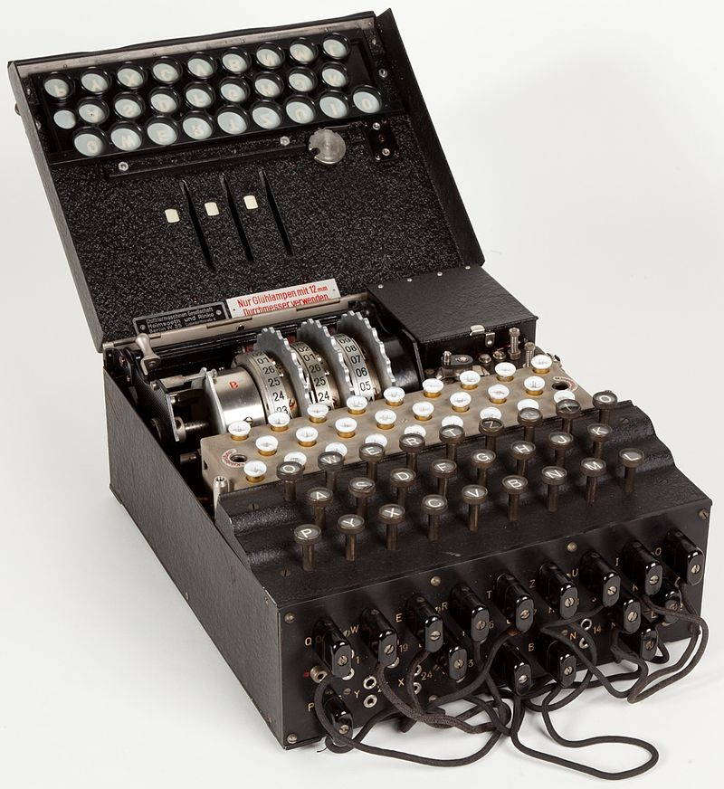
Cryptography (continued)
Enigma Machine
Possibly the most famous substitution cryptography machine and used by the German military during World War II
Roughly equivalent to a 76-bit encryption key

Slide 14
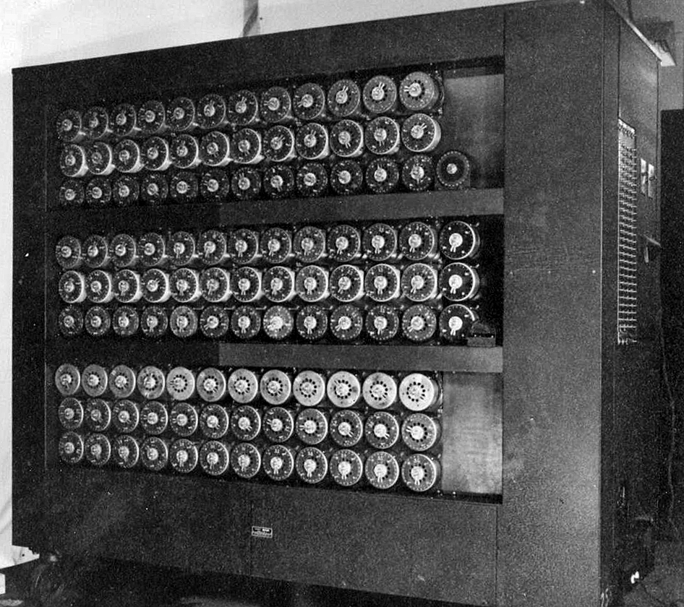
Cryptography (continued)
Turing Bombe
An electro-mechanical device used by British cryptologists to help decipher German Enigma-machine-encrypted secret messages during World War II.

Slide 15
Cryptography (continued)
Common terms when dealing with cryptography
Cleartext/Plaintext – Unencrypted data
Ciphertext – Encrypted data
Key - Information, usually a string of numbers or letters, used to create the encryption and/or decryption process
Algorithm - The mathematical equation used to scramble/descramble the plain text and make it unreadable/readable
Encryption - Scrambles the original data (cleartext) into an unreadable format (ciphertext) using an algorithm and a key.
Hash - Used to create a fixed-size string of characters (hash value or digest) from input data of any size. The purpose of hashing is mainly to verify data integrity and to quickly compare large sets of data.

Slide 16
Cryptography (continued)
Hash (continued)
Hashing is a one-way function; it cannot be reversed back to its original form.
Ensures data integrity and authenticity but does not provide confidentiality.
Encryption vs Hashing
Encryption: Encryption is commonly used in securing communications (e.g., HTTPS), protecting sensitive data in databases, and securing files and emails.
Hashing: Hashing is used for password storage (storing hashed passwords instead of plaintext), digital signatures, data integrity verification, and in cryptographic protocols.
While both are cryptographic techniques used to protect data, encryption focuses on confidentiality and reversible transformation, while hashing focuses on data integrity, authenticity, and irreversible transformation.

Slide 17
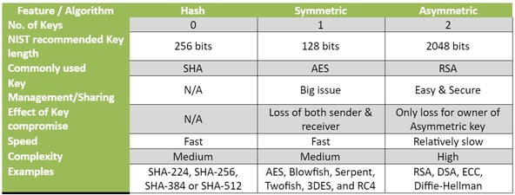
Key Algorithms

Slide 18
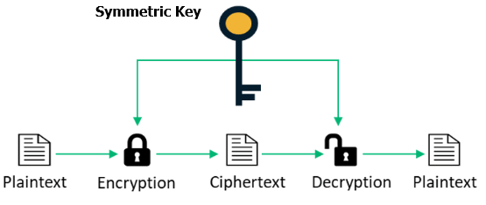
Symmetric and Asymmetric Key Encryption
There are three types of cryptography:
Symmetric Key - Uses the same cryptographic keys for both the encryption of plaintext and the decryption of ciphertext
Examples of popular symmetric-key algorithms include Twofish, Serpent, AES, Blowfish, CAST5, RC4, DES, 3DES, Skipjack, and IDEA

Slide 19
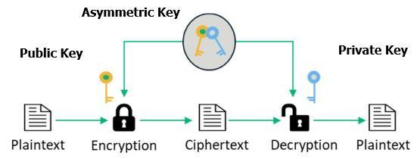
Symmetric and Asymmetric Key Encryption
Asymmetric Key - Separate keys (public and private) are used for encryption and decryption, respectively, enabling secure communication and digital signatures without the need for both parties to share the same secret key
Examples of popular symmetric-key algorithms include Diffie-Helman, DSS, ECDSA, and RSA

Slide 20
Asymmetric Key Algorithms
Also referred to as Public Key algorithms, the user has both a public key and a private key:
Private Key is to be kept secured
Public Key is easily accessible
Asymmetric encryption includes the following steps:
A signer sends a public key to a receiver.
The signer uses the private key to sign data.
The signer sends the data and signature to the receiver.
After the receiver receives the data and signature, the receiver can use the public key to verify the signature of the signer.

Slide 21
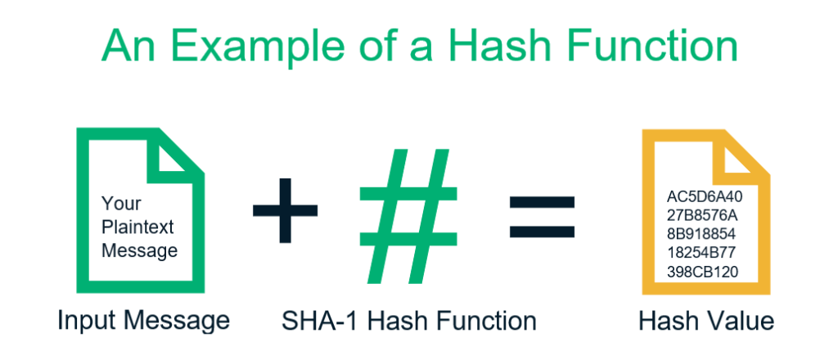
Symmetric and Asymmetric Key Encryption
Hash Function - a mathematical algorithm that takes a message and produces a fixed-size string of characters. Commonly used for authenticating messages as well as content verification and digital signatures
Examples of popular hash functions include CRC, MD5, and various Checksums

Slide 22
Symmetric and Asymmetric Key Encryption
Symmetric encryption is faster due to its simpler algorithms and key management processes. Decryption is typically as fast as encryption.
Asymmetric encryption sacrifices speed for the added security provided by its public-private key pair system, so it tends to be slower compared to symmetric encryption and description.
It’s worth noting that the time taken for Asymmetric decryption is not as significant during encryption.
Based on these differences, we can see why we can leverage one form, or the other, for different applications; and in some cases, use both.

Slide 23
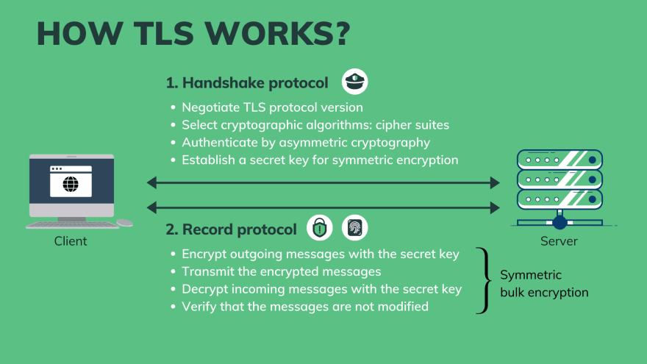
Symmetric and Asymmetric Key Encryption
SSH/SSL/TLS uses both asymmetric and symmetric encryption to protect the confidentiality and integrity of data-in-transit. Asymmetric encryption is used to establish a secure session between a client and a server, and symmetric encryption is used to exchange data within the secured session.

Slide 24
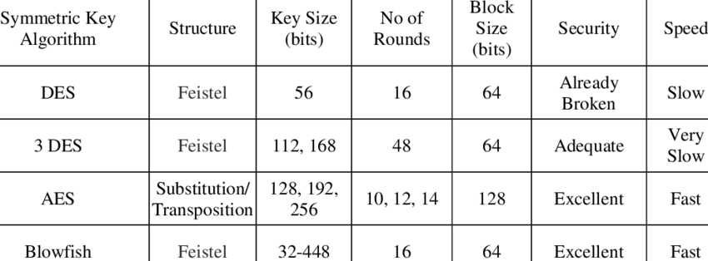
Symmetric Key Encryption

Slide 25
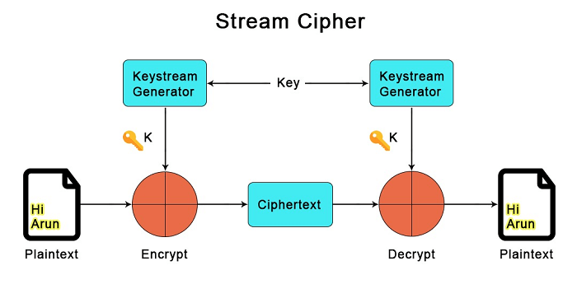
Symmetric Key Encryption (continued)
Stream Ciphers
A type of symmetric key encryption algorithm used in cryptography to encrypt data one bit or one byte at a time, continuously streaming through the data.
They are often synchronous, meaning they use a clock or synchronization mechanism to ensure that the sender and receiver generate the same key stream at the same time. The synchronization ensures that the encryption and decryption processes remain aligned.

Slide 26
Symmetric Key Encryption (continued)
Stream Ciphers (continued)
If a character is corrupted in transmission, rather than added or lost, so that if only a single character in the plaintext is affected and the error will not propagate to other parts of the message.
This property is useful when the transmission error rate is high; however, it makes it less likely the error would be detected without further mechanisms.
Moreover, because of this property, synchronous stream ciphers are very susceptible to active attacks: if an attacker can change a character in the ciphertext, they might be able to make predictable changes to the corresponding plaintext bit; for example, flipping a bit in the ciphertext causes the same bit to be flipped in the plaintext.

Slide 27
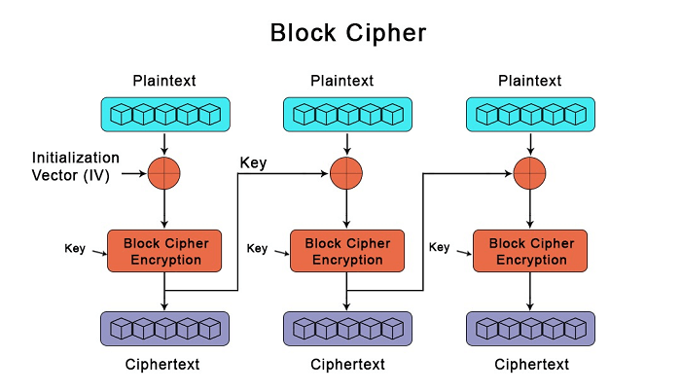
Symmetric Key Encryption (continued)
Block Ciphers
A deterministic algorithm that operates on fixed-length groups of bits, called blocks. They are commonly used in the storage and exchange of data, where such data is secured and authenticated via encryption.
Padding can be used to ensure the block is consistent

Slide 28
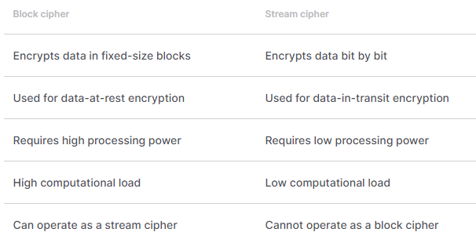
Symmetric Key Encryption (continued)
Stream vs Block Ciphers
The most obvious difference between the block cipher and stream cipher is how they process data. Block cipher encrypts the plaintext in predetermined-size blocks, whereas stream cipher encrypts the plaintext matching it bit by bit with the generated keystream.

Slide 29
Cryptanalysis
A cryptanalyst is the individual who will find weaknesses in cryptographic algorithms and use these weaknesses to decipher the ciphertext without knowing the secret key.
Six months after the attack on Pearl Harbour in WWII, American intelligence discerned that the Japanese were orchestrating a significant offensive, as encrypted transmissions consistently referenced the cryptic target "AF". However, the specific identity of "AF" remained uncertain. Joseph "Joe" Rochefort, the lead cryptanalyst, devised a strategic move by disseminating a fabricated message suggesting that the Midway garrison had disrupted water evaporator units on the island. Almost immediately, American monitoring stations intercepted Japanese communications discussing the water scarcity issue and the imperative to carry additional water resources for the impending operation targeted at "AF".

Slide 30
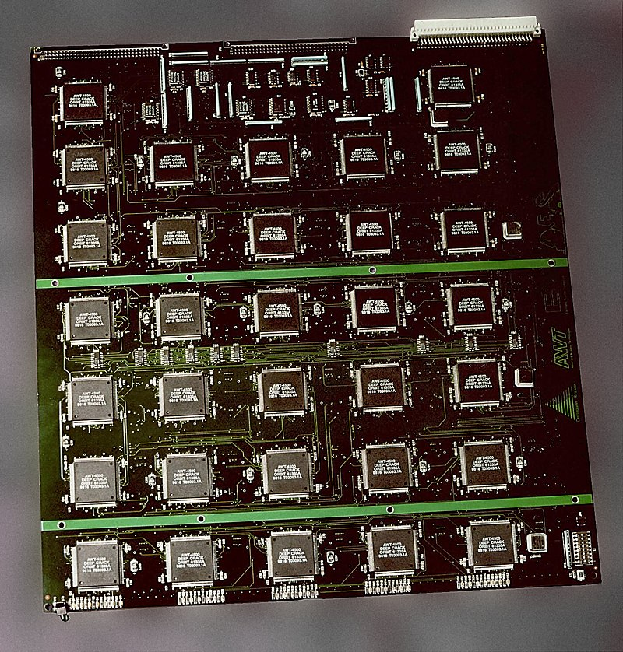
Symmetrical Key Ciphers (continued)
DES (Data Encryption Standard)
Developed in the early 1970s at IBM
DES is insecure due to the relatively short 56-bit key size. In January 1999, distributed.net and the Electronic Frontier Foundation collaborated to publicly break a DES key in 22 hours and 15 minutes. Image below shows one of the circuit boards in the $250,000 cracking machine which contained 1856 custom chips.

Slide 31
Symmetrical Key Ciphers (continued)
3DES (Data Encryption Standard)
A symmetric-key block cipher, which applies the DES cipher algorithm three times to each data block.
In 2016, CVE-2016-2183 disclosed a major security vulnerability in DES and 3DES encryption algorithms.
This CVE, combined with the inadequate key size of DES and 3DES, led to NIST deprecating DES and 3DES for new applications in 2017, and for all applications by the end of 2023. It has been replaced with the more secure, more robust AES.

Slide 32
Symmetrical Key Ciphers (continued)
AES (Advanced Encryption Standard)
Also known as Rijndael
Block cipher adopted for the encryption of electronic data established by the U.S. National Institute of Standards and Technology (NIST) in 2001.
Replaced DES which was published in 1977.
Uses a fixed block size of 128 bits, and a key size of 128, 192, or 256 bits.
Faster than DES, but slower than Blowfish
Attacks have been published that are computationally faster than a full brute-force attack, though none as of 2023 are computationally feasible.

Slide 33
Symmetrical Key Ciphers (continued)
Blowfish
Designed in 1993 and included in many cipher suites and encryption products. Blowfish provides a good encryption rate in software, and no effective cryptanalysis of it has been found to date.
It has a 64-bit block size and it supports key lengths of 32-448 bits.
It is fully in the public domain, open-source and royalty-free as per its creator, Bruce Schneier.

Slide 34
Symmetrical Key Ciphers (continued)
Skipjack
NSA-developed encryption algorithm that was developed for use in the Clipper chip (an encryption device that secured "voice and data messages" with a built-in backdoor that was intended to "allow Federal, State, and local law enforcement officials the ability to decode intercepted voice and data transmissions.)
Uses an 80-bit key size and operates on 64-bit blocks
Vulnerable to various attack methods
RC5
Designed by RSA Data Security, Inc.
Unlike others, RC5 has a variable block size (32, 64 or 128 bits) and a variable key size (0 to 2040 bits)

Slide 35
Asymmetric Key Ciphers
RSA (Rivest, Shamir, and Adleman)
RSA develops keys that are the product of two 1024-bit prime numbers
RSA was created with the knowledge that it is very difficult to factor large numbers
Key sizes typically range from 2,048 to 4,096 bits
RSA is a relatively slow algorithm. Because of this, it is not commonly used to directly encrypt user data. More often, RSA is used to transmit shared keys for symmetric-key cryptography, which are then used for bulk encryption–decryption.
Vulnerable to Shor's Algorithm for quantum computers and has broken an 829-bit key

Slide 36
Asymmetric Key Ciphers (continued)
Diffie-Hellman
Allows two parties who do not have prior knowledge of each other to establish a shared secret key over a public, insecure channel
4 Steps involved for DH:
1. Key Generation
Each party generates a public-private key pair.
The public key is shared openly, while the private key is kept secret.
2. Exchange of Public Keys
Both parties exchange their public keys over the insecure communication channel.
3. Key Derivation
Using their own private key and the received public key, each party independently computes a shared secret key.
The mathematics involved make it computationally infeasible for an eavesdropper to derive the shared key without knowledge of at least one of the private keys.
4. Shared Secret
Both parties now possess a shared secret key, which can be used for further symmetric-key encryption to secure their communication.

Slide 37
Asymmetric Key Ciphers (continued)
ECC (Elliptic Curve Cryptosystems)
ECC uses an approach to public-key cryptography based on the algebraic structure of elliptic curves over finite fields.
ECC allows for smaller keys compared to non-ECC
Elliptic curves are applicable for key agreement, digital signatures, pseudo-random generators among other uses.
Lattice-Based Cryptosystems
This is more of a generic term for constructions of cryptographic primitives that involve lattices, either in the construction itself or in the security proof
Lattice-based constructions support important standards of post-quantum cryptography

Slide 38
Cryptographic Hash Functions
Hash functions are used in cryptography to transform variable length into a fixed-size hash value
Hashed passwords cannot be decrypted, but they might be able to be reverse-engineered. For example, if we have 2 users with the same password, that hashed value will be identical.
Hashed passwords can be ‘salted’. This is an additional input that’s added during the hashing function adding to the complexity of the result, even if the attacker knows the salt value.
Message Digest Algorithm 5 (MD5)
Secure hash algorithm developed in 1992 by Rivest
Operates on input data using 512-bit blocks, and produces a 128-bit hash value
Considered cryptographically broken and insecure for hashing passwords or any sensitive data, even though as of 2019, one quarter of widely used content management systems were reported to still use MD5 for password hashing.

Slide 39
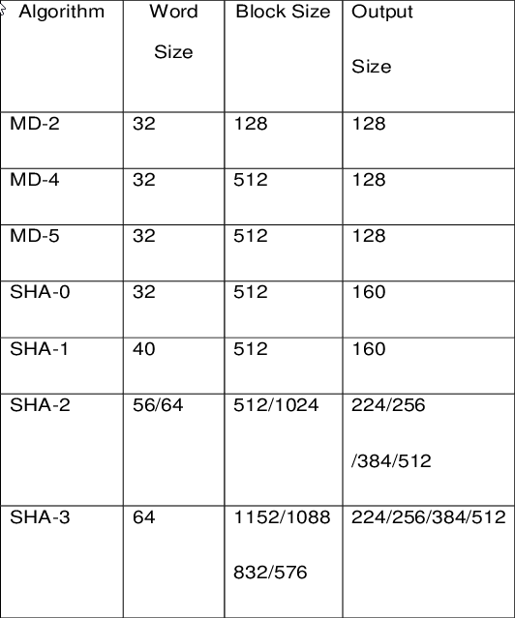
Cryptographic Hash Functions (continued)
SHA, SHS (Secure Hash Algorithm)
Published by NIST (National Institute of Standards and Technology) and adopted as a FIPS (Federal Information Processing Standard) standard
Several variations of SHA hash functions exist

Slide 40
Attacks on Passwords
Acquiring passwords ranges from mundane methods like shoulder-surfing to inventive technological ideas.
A Side-Channel Attack is any attack based on extra information that can be gathered because of the fundamental way a computer protocol or algorithm is implemented, rather than flaws in the design of the protocol or algorithm itself
According to a study, it is possible to use an acoustic SCA, to interpret sound signals from your keyboard strokes to get your password. They used MacBook Pro 16-inch laptops to conduct their study and successfully gathered passwords using a smartphone, a Zoom call, and deep learning technology.
TEMPEST is a U.S. NSA specification and a NATO certification referring to spying on information systems through leaking emanations, including unintentional radio or electrical signals, sounds, and vibrations.

Slide 41
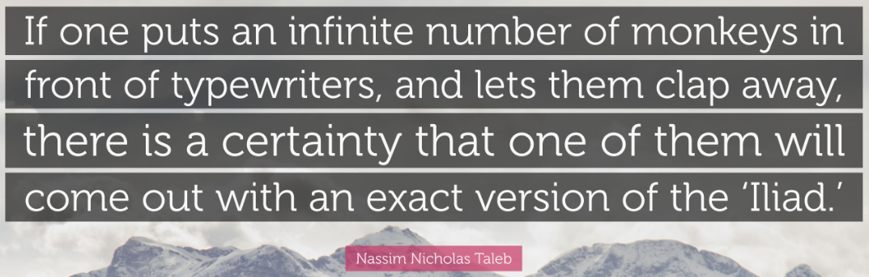
Brute Force Attacks
Brute forcing is a hacking method that uses trial and error to crack passwords, login credentials, and encryption keys
One can limit the frequency of online login attempts to an account by:
Locking an account after a specified number of login attempts is reached
Enforcing 2FA, CAPTCHA, reCAPTCHA, Animal Species Image Recognition for Restricting Access (ASIRRA), etc…
Prohibiting multiple login attempts from a single IP address

Slide 42
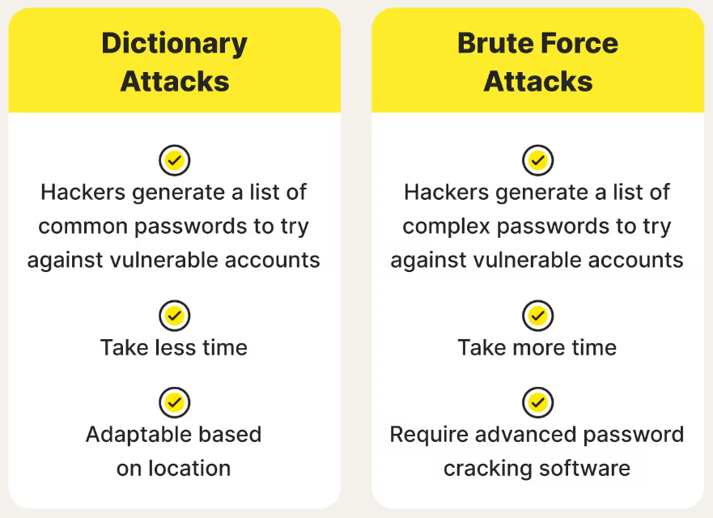
Dictionary Attacks
Dictionary attacks resemble brute forcing in methodology, yet they differ by drawing from a predefined list of words rather than generating random characters
When attempting to guess passwords, brute force is highly efficient in rapidly checking short passwords
Alternatively, longer passwords could potentially be vulnerable to dictionary attacks, given that brute-force searches are typically time-consuming

Slide 43
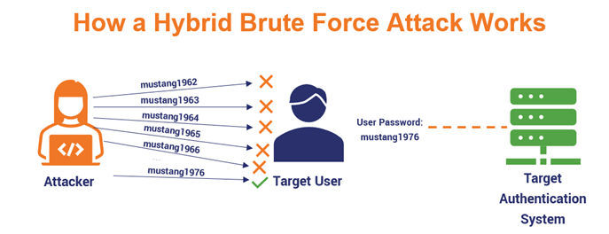
Dictionary Attacks (continued)
Hybrid Attacks
Refers to the blending of two, or more, kinds of tools to carry out the assault
Having any sort of definitive information about the makeup of a password can greatly speed up a hybrid attack
In this case, the attacker would merge a dictionary attack and a brute-force attack. The former would contain a list of potentially known credential matches (wordlist). The latter would apply a brute-force attack upon each possible match.

Slide 44
Dictionary Attacks (continued)
Hybrid Attacks
Substitution: replacing letters/numbers in words with letters/numbers/symbols that look similar to the missing characters
Appending Characters: adding characters to the end of words
Reversing Words: simply inputting in reverse
Duplication: Using the same word twice to create a new word
Number Spread: Inserting numbers into the password

Slide 45
Dictionary Attacks (continued)
Guidelines to protect against dictionary and hybridization attacks
Avoid using the same password for everything
Avoid using names of people in a password, this includes relatives, friends, or pets
Avoid using common words or names for passwords
Include random letters, numbers, and characters
Avoid writing down difficult passwords where they might easily be found
The longer the password is, the longer it takes to crack.

Slide 46
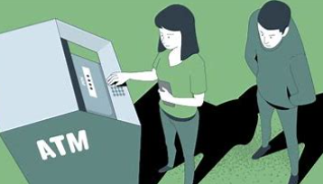
Observation
“Snooping,” “eavesdropping,” or “shoulder-surfing” are all methods of acquiring sensitive information
Used whenever an attacker has physical proximity and can watch the victim type in credentials

Slide 47
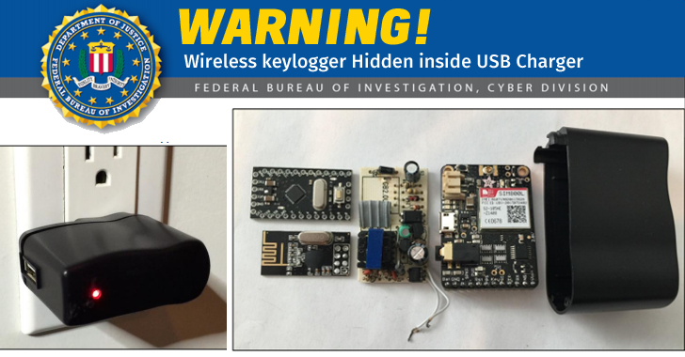
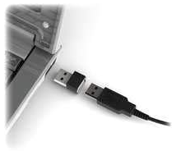
Keyloggers
Records the pressed keys, and even the mouse on the target’s computer
These exist as software and/or hardware
Malware can carry keyloggers, and transmit their logs back to a server
Hardware keyloggers are identifiable, but most people don’t inspect their computers on a daily basis

Slide 48
Password File Stealing
If the attacker can gain access to the physical computer they can steal or copy the files where the password hashes are stored from the victim’s computer
They can then take all the time necessary to perform a brute-force attack
Sometimes passwords are not stored in the main system but in a shadow file and readable only by users with administrative privileges

Slide 49
Password Crackers
Some widely used cracker programs are:
Hashcat
Brutus
John the Ripper
Wfuzz
THC Hydra
Medusa
RainbowCrack
OphCrack
L0phtCrack
Aircrack-ng

Slide 50

HashCat
Touted as the “World's fastest and most advanced password recovery utility”
Free & open source (MIT License)
Capable of cracking more than 350 ciphers
The list of attack modes include:
Straight
Combination
Brute-force
Hybrid dictionary + mask
Hybrid mask + dictionary

Slide 51
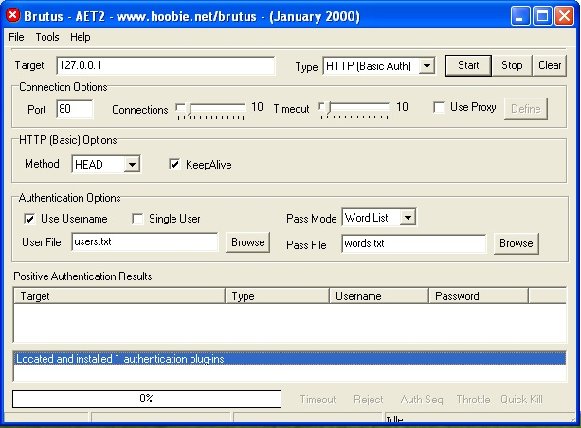
Brutus
This is a Windows-only password cracking tool, and is portable
Originally designed as a utility to test for default credentials for routers
Supports cracking passwords of various protocols:
HTTP (Basic authentication)
HTTP (HTML form/CGI)
POP3
FTP
SMB
Telnet
It has three attack modes:
Wordlist
Brute-force
Combination

Slide 52

John the Ripper
Released in 1996 as a Unix password cracker, and is currently available for many flavors of Unix, macOS, Windows, DOS, BeOS, and OpenVMS
It has three attack modes:
Wordlist
Single-crack
Incremental (Brute-force)
Has a Pro version for Linux & macOS

Slide 53

Wfuzz
A tool designed for bruteforcing Web Applications, it can be used for finding resources not linked directories, servlets, scripts, etc, bruteforce GET and POST parameters for checking different kind of injections (SQL, XSS, LDAP,etc), bruteforce Forms parameters (User/Password), Fuzzing, etc.
Can perform various functions such as:
Manipulate form-encoded data like in an HTML form, this is ideal for injection attacks
Sending pre-built cookies to a server
Brute forcing common credentials

Slide 54

OphCrack
Free Windows password cracker based on rainbow tables. It is a very efficient implementation of rainbow tables done by the inventors of the method. It comes with a Graphical User Interface and runs on multiple platforms.
A selection of Rainbow tables is available on their homepage
Can be either installed or run on a LiveCD

Slide 55

L0phtcrack
An alternative to OphCrack. It attempts to crack Windows passwords from hashes. For cracking passwords, it uses Windows workstations, network servers, primary domain controllers and Active Directory. It also uses dictionary and brute-force attacks for generating and guessing passwords. It was acquired by Symantec and discontinued in 2006. Later, L0pht developers again reacquired it and launched L0phtCrack in 2009.

Slide 56
Summary
Requiring the use of effective, strong passwords is one of the best ways to secure a network against attackers
Basic types of cryptography include transposition and substitution ciphers
Encryption can be performed using either symmetric key algorithms or asymmetric key algorithms
Popular symmetric key ciphers include DES, 3DES, AES (Rijndael), IDEA, Skipjack, and RC4

Slide 57
Summary (continued)
Popular asymmetric key ciphers include RSA, Diffie-Hellman, DSS, and elliptic curve cryptography
Cryptographic hash functions generate a fixed-size hash value from a message of any length
Effective password security depends on choosing strong passwords
Common attacks on passwords include technical measures and physical techniques
Password-cracking programs are readily available

